Slide 1

CEIR Manufacturer Training Manual

Slide 2

Agenda
Manufacturer Definition and Overview
Assumptions
Features
Registration
Dashboard
Stock Management
Grievance
Profile Management

Slide 3
Manufacturer - Definition
The manufacturer of SIM based devices can be
Anyone in the global market who produces the device and from where the devices are imported
Any local entity who produces and sells the devices in the country itself.
CEIR system only consider the local entity who produces and sell the devices in the country itself.
Manufacturer will sell the devices to distributor and retailer.
Manufacturer is the one who
Produce the complete device
Import part of the devices but do the assembly of devices in Cambodia
Brand Owner, who import devices but sell under his own brand in the Country
Manufacturer will be requesting for TAC from the GSMA before producing the SIM based devices

Slide 4
Overview
Manufacturer has to register using DMC Home Portal
As part of registration process, Manufacturer will receive the username and password which can be then used to login to the CEIR Portal
Once logged into the CEIR portal, Manufacturer can perform following operations
Stock Management
Grievance Management
Profile Management
Manufacturer can see the status of ongoing activity through the Dashboard feature
Email Notification to keep track of the status of various operations

Slide 5
Assumption
There will be regulation in place for Manufacturer to register with CEIR authority in the respective phases of project rollout
Regulation is in place for companies for Manufacturer have valid VAT registration
Regulation has to be in place for rejecting the device upload based on the Invalid TAC from the Manufacturer

Slide 6
Registration – Manufuacturer

Slide 7
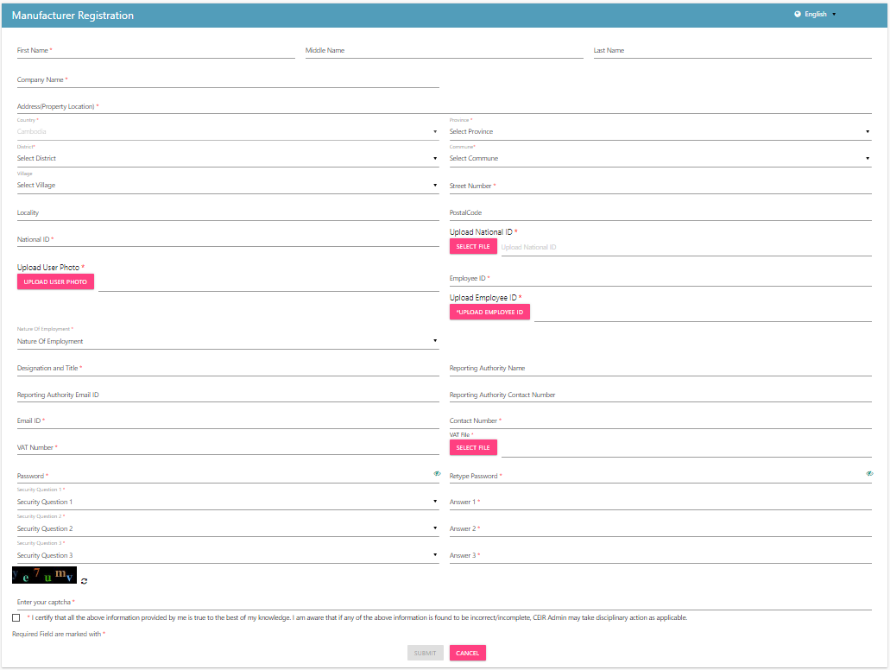
Registration – Manufacturer (Form)

Slide 8
Dashboard – Manufacturer
The panel on the left displays all the operations that a manufacturer can perform.
The work area on the right-hand side displays the status of all the features
Stock requests uploaded by the Manufacturer
Total devices waiting for upload
Total Grievances raised by the Manufacturer
The work area also displays notifications on the Manufacturer raised feature requests.
The top right panel has download option where the Manufacturer can download the User
Manual for his reference.
Manufacturer can also change their profile language to Khmer.

Slide 9
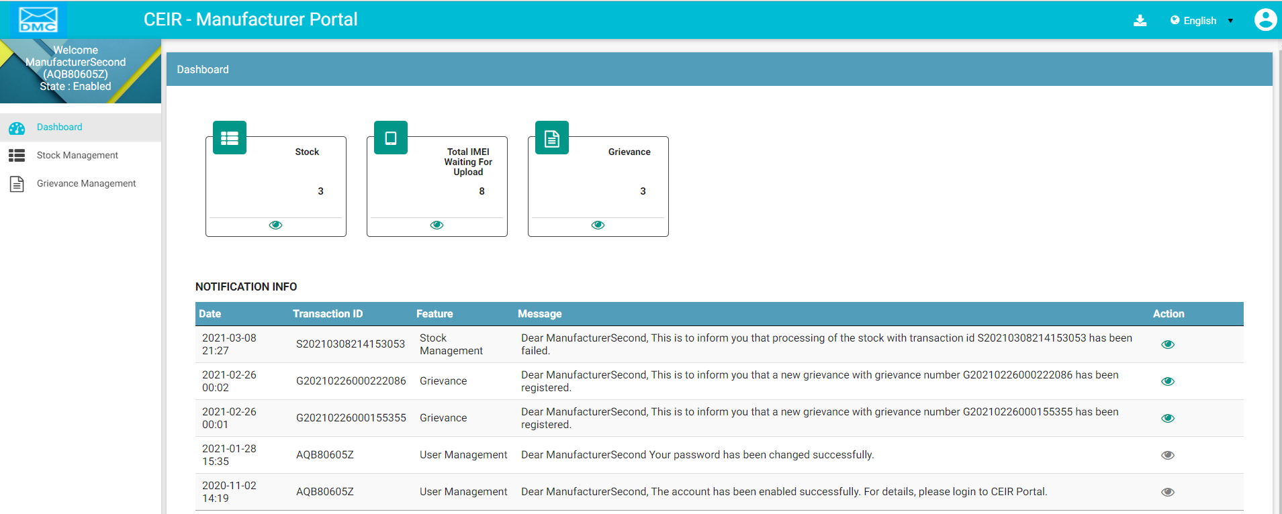
Dashboard – Manufacturer
Download User Manual
All features status
Left Panel
Work Area
Edit Profile
Language Change
Notifications

Slide 10
Stock Management – Manufacturer

Slide 11
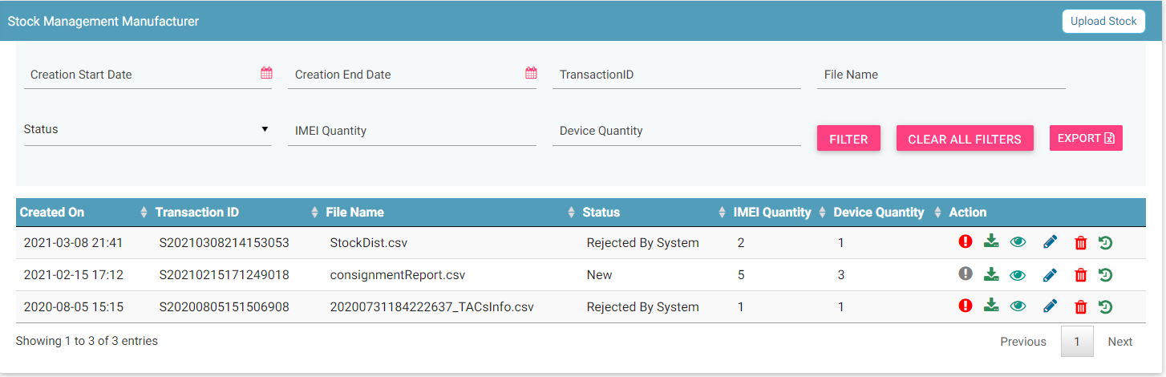
Stock Management – Manufacturer
Filters
Upload
Export
Action like View, Delete
View All Stocks

Slide 12
Grievance – Manufacturer
As an manufacturer, you can register grievances when there is a problem in the portal.
For example, there could be situations when the registration feature is not working or there could be a problem in stock upload.
Once a grievance is raised, it reaches the CEIR Admin queue for response from CEIR Authority.
CEIR Admin can ask for more details in case required.
Else CEIR Admin will respond and close the grievance.

Slide 13
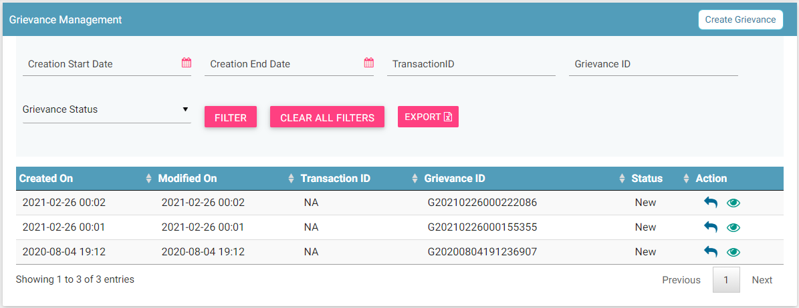
Grievance – Manufacturer
Report
Filters
Export
Action like View, Reply
View grievances

Slide 14
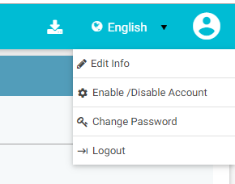
Profile Management – Manufacturer

Slide 15
Queries

Slide 16
Thank You

